Slide 1


01
Object Oriented Programming
Java Object Oriented Programming

Slide 2
02
Review of Lectures/Today's Agenda
What is an Object?
What is a Class?
What is Object Orientated Programming

Slide 3


03
This slide set is a little longer than usual. We will not get through it all, but this is our last session. You can use the rest of it on your own.

Slide 4


11
CLASSES
We have been using classes this whole semester. We know will began to understand what a class is.

Slide 5
Reusable Code/Scalability

Slide 6
An object is a real-world entity!
Do not think any deeper than that!
A class is a template for all objects of that TYPE.

Slide 7
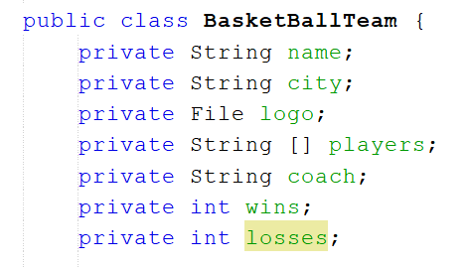

Slide 8
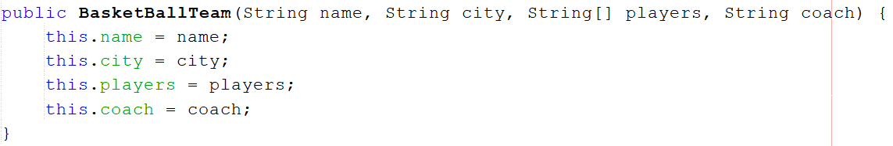

Slide 9
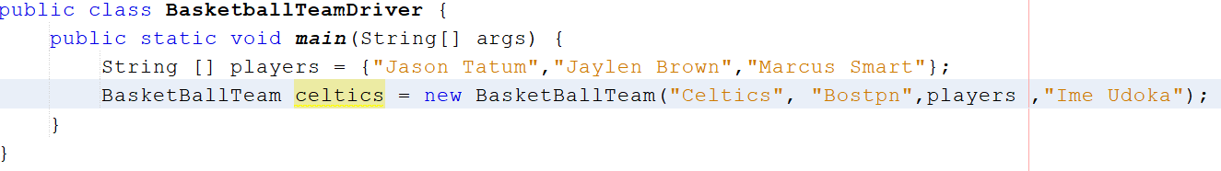

Slide 10
Instance Variables
The data in a class is called an instance variable

Slide 11
These are attributes/properties/member data

Slide 12
Objects also have Behaviors(methods)

Slide 13
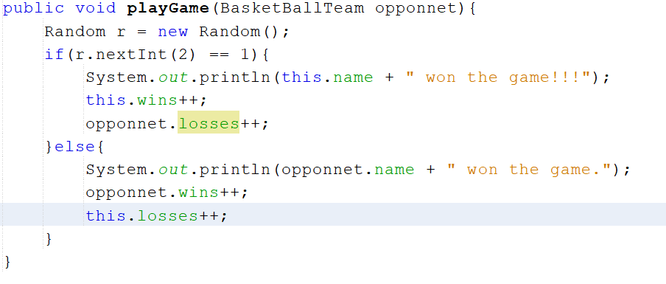

Slide 14

NOW WE WILL MAKE A CLASS TOGETHER. THAN CREATE INSTANCES OF THAT CLASS (I.E AN OBJECT)

Slide 15


OBJECT ORIENTED PROGRAMMING IS A PARADIGM SHIFT (DIFFERENT TECHNIQUE OF PROGRAMMING)

Slide 16
Let's solve Exercise 07_03 using OOP. (Move to Netbeans).
If you are reading this at home. Email me and I will send
03

